Slide 1

Blended Retirement System (BRS)
January 2026

Slide 2



Agenda
Retirement Planning and Financial Readiness
The Uniformed Services Blended Retirement System (BRS)
Understanding the Thrift Savings Plan (TSP)
How TSP Affects Future Retirement Savings and Military Pay
Managing Retirement Savings

Slide 3

Discussion
What do you want your life to look like at age 55?

Slide 4






Why Save Now for Retirement?
Time is your ally
Start now and stay consistent
Inflation
Compound earnings
Matching contributions
Financial freedom

Slide 5
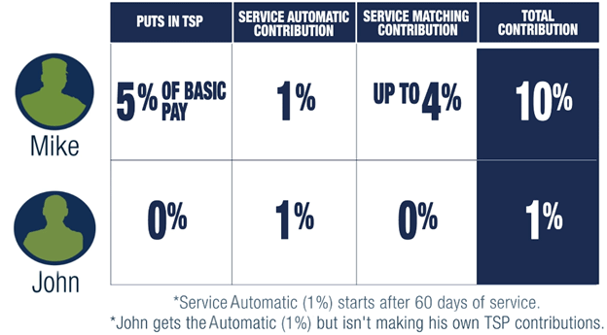
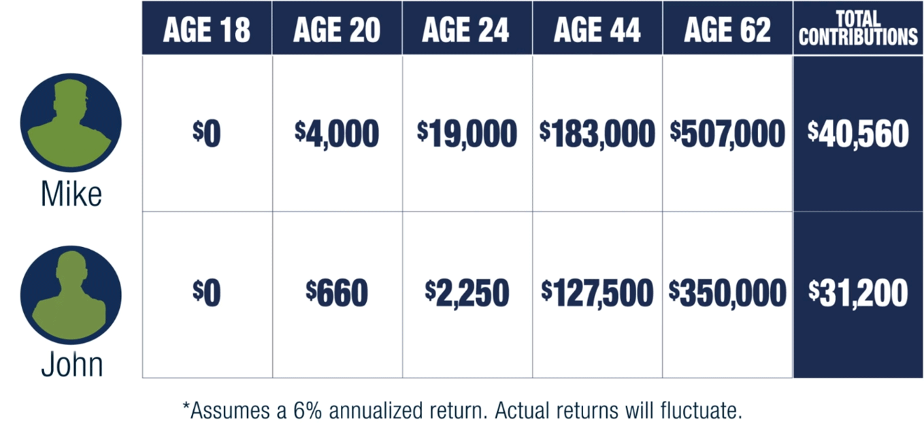
Retirement Savings
Age started investing:
Mike – 18
John – 24
TSP contribution:
Mike – 5% basic pay
John – None
Estimated earnings by age 62:
Mike – $507,000
John – $350,000

Slide 6

Knowledge Check
Retirement savings grow faster when they benefit from ______ ______, because your money earns returns not only on the original contributions but also on the interest earned on those contributions.
Compound earnings

Slide 7
Discussion
What are some barriers you may face when trying to save for retirement?

Slide 8





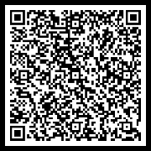
Blended Retirement System
Defined Benefit
Pension
Defined Contribution
Thrift Savings Plan
Continuation Pay
Mid-career bonus
Lump Sum Option
Discounted portion of retired pay
BRS Guide

Slide 9
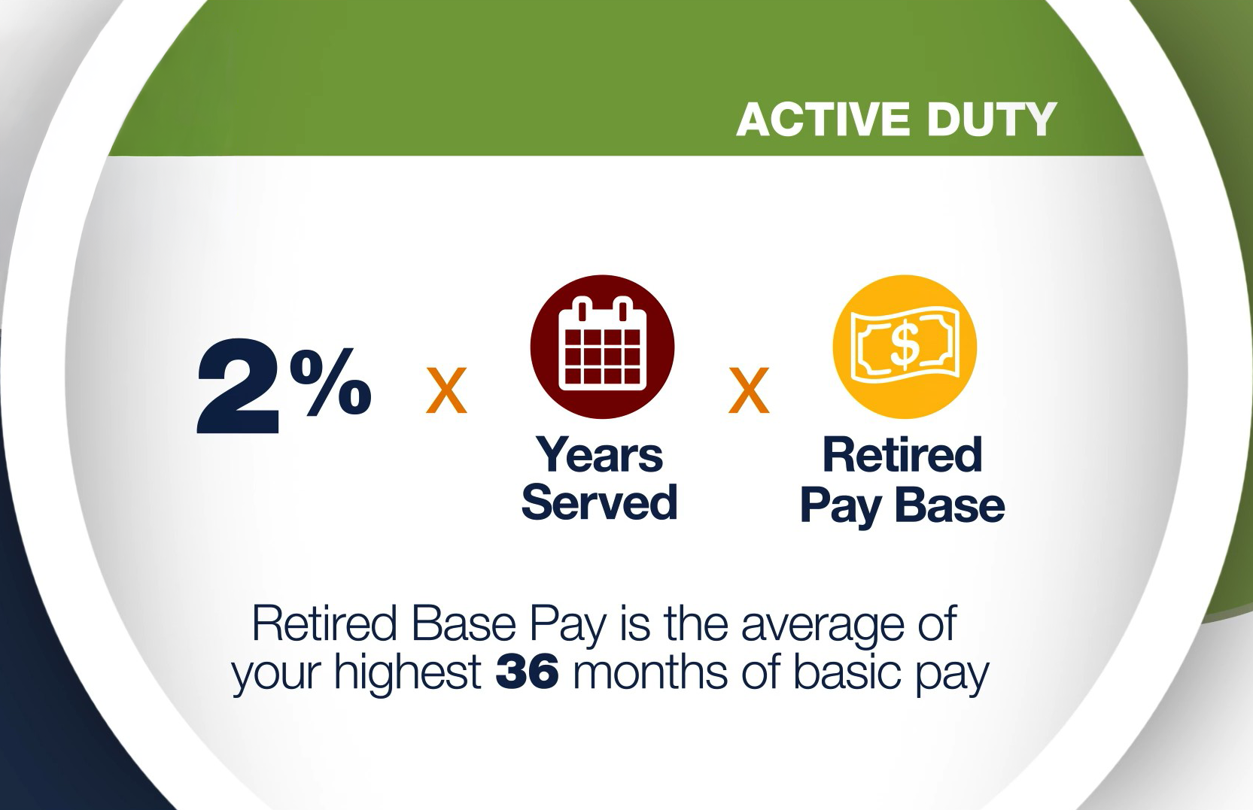
Defined Benefit
Earned after 20 qualifying years of service
2.0% x Years Served x Retired Pay Base
National Guard/Reserve member: Total number of retirement points/360 = Equivalent years of service

Slide 10
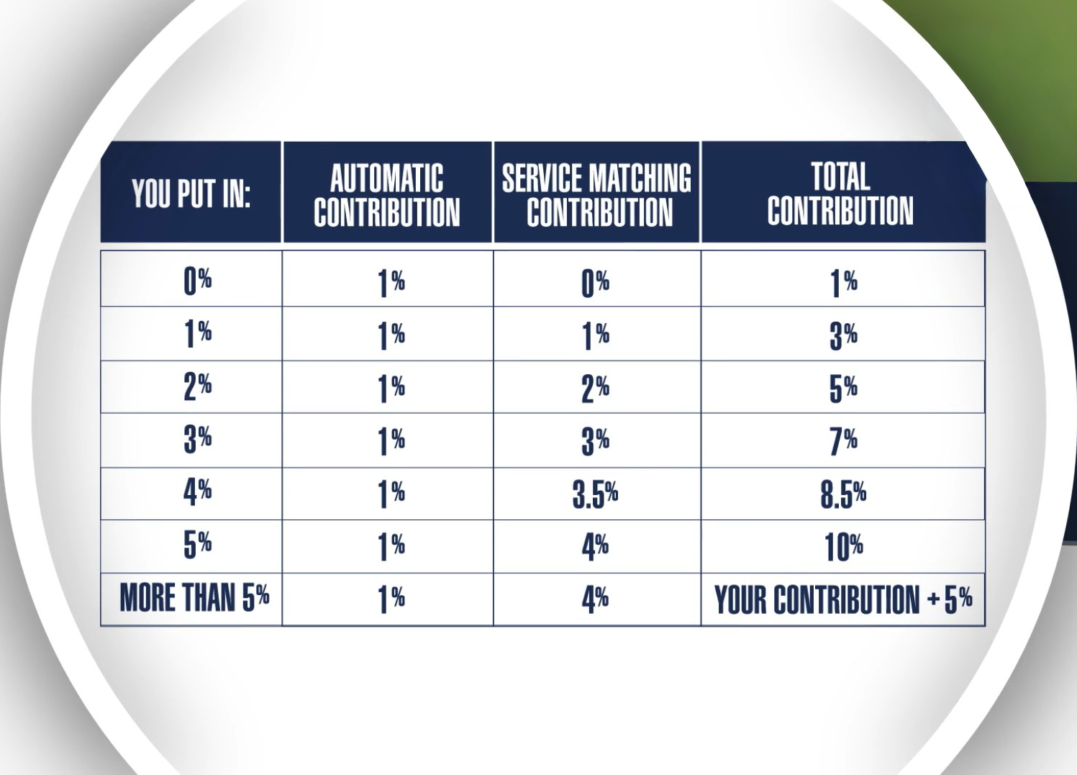
Defined Contribution
Automatically enrolled after 60 days of service
5% of basic pay automatically deducted and contributed to your TSP
Contributions go toward age-appropriate lifecycle fund
Service Automatic (1%) Contribution and Service Matching Contributions made with pre-tax dollars
Vested after 2 years of service from PEBD

Slide 11
Leave and Earnings Statement (LES)
(Please note: LES formats can vary. The example shown may not reflect all versions across all Services.)

Slide 12
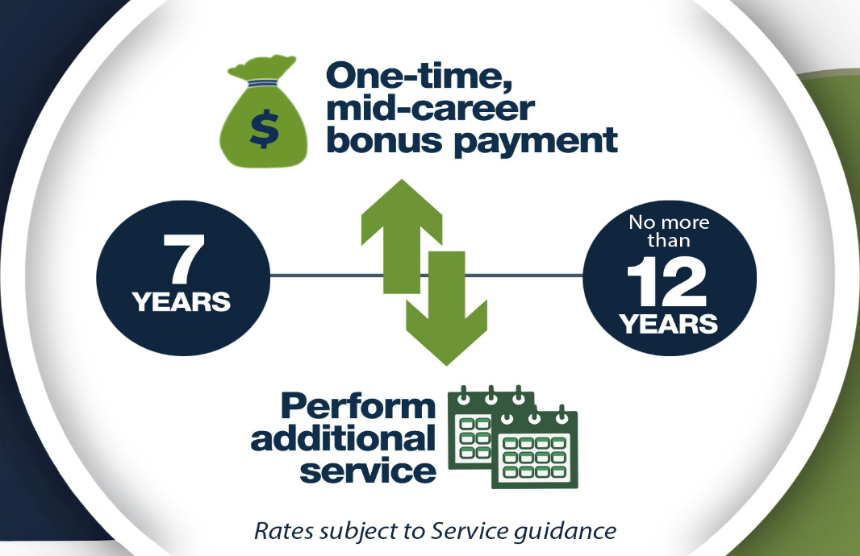
Continuation Pay
One-time, mid-career bonus
Eligible between 7 and no more than 12 years of service from PEBD
Requires additional obligated service
Amount/timing determined by each Service

Slide 13
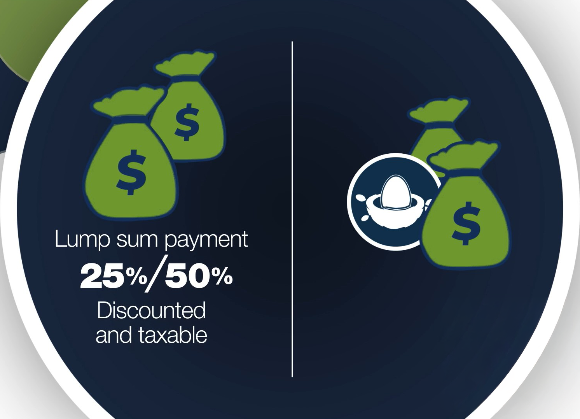
Lump Sum Option
Take 25% or 50% of retired pay up front at retirement
Lump sum is discounted and taxable
Monthly pay reduced until reach Social Security retirement age

Slide 14
Knowledge Check
How long do you have to serve in order to keep the Service Automatic (1%) Contribution and its earnings?
2 Years

Slide 15
Knowledge Check
How many months after your pay entry base date (PEBD) do Service Matching Contributions begin?
25 Months from PEBD

Slide 16

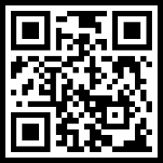
Thrift Savings Plan Basics
Contribute 1% - 100% of incentive pay, special pay, and/or bonus pay
Traditional vs Roth account
Traditional: pre-tax
Roth: after-tax
Fund selection
Monitor account
Designate beneficiaries
TSP.gov

Slide 17
Thrift Savings Plan
Time
Investment performance
Contributions your Service makes
How much you contribute
Growth Factors

Slide 18

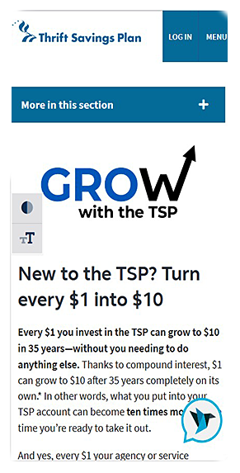





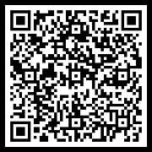
TSP Summary
Retirement savings plan
Offers Traditional and Roth accounts
Contribution guidelines:
Elections made through your pay system
Contribute from basic, incentive, special and/or bonus pays (1-100%)
Know IRS annual contribution limits
Fund selection
TSP contribution calculator
TSP Contribution Calculator

Slide 19
Knowledge Check
Where do you make changes to your TSP contribution elections?
Service payroll system

Slide 20
Knowledge Check
What is a Service member’s default contribution rate and what age-appropriate, professionally managed fund does it go into?
Default rate: 5%; Fund: Lifecycle

Slide 21
Discussion
What would motivate you to start saving today – even if retirement feels far off?

Slide 22




Savings and Pay
Start early and contribute consistently to maximize potential earnings
Compound interest
Accelerates your savings growth
Maximize Service Matching Contributions

Slide 23
Discussion
Why is it important to actively manage your TSP account, instead of simply setting it up and leaving it alone?

Slide 24

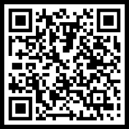
Managing Retirement Savings
Actively manage your TSP through TSP.gov or the TSP app
Your TSP account is portable
Personal financial managers/counselors
PFC Map

Slide 25
Discussion
What is one step you can take to improve your financial security, and why act now?

Slide 26

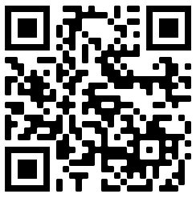
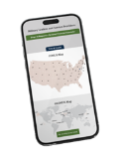


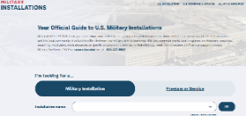






Financial Readiness Resources
Visit the FINRED website at https://finred.usalearning.gov/ for original, reliable and up-to-date financial information you can count on.
SCAN ME
Use the Personal Financial Counselor Locator Map to find:
Free financial counselors both CONUS and OCONUS
Financial literacy education, training and resources
https://finred.usalearning.gov/pfcMap
Discover MilSpouse Money Mission resources including:
Money Ready curriculum
MilLife Milestones
Videos, blogs and more
Sign up for our eNewsletter designed for Service members and spouses and service providers at:
https://finred.usalearning.gov/eNews-subscriber
MilitaryINSTALLATIONS connects you to local programs, services and resources:
https://installations.militaryonesource.mil/
Follow DoD FINRED:

Slide 27








Thank You!
Our website: https://finred.usalearning.gov/
LinkedIn: https://www.linkedin.com/company/DoDFINRED
Facebook: https://www.facebook.com/DoDFINRED
X: https://www.X.com/DoDFINRED
Instagram: https://www.instagram.com/DoDFINRED
YouTube: https://www.youtube.com/DoDFINRED
MilSpouse Money Mission: https://www.milspousemoneymission.org
Scan to visit finred.usalearning.gov

